Slide 1

ELC Molecular Epi Training Nextstrain Narrative Practice on HPAI
Leke Lyu & Tanin Rajamand
20 June 2024

Slide 2
The Nextstrain Build has already been done for you. All Nextstrain Build output folders are available in the Supporting Materials/HPAI folder.
Files we need to check:
colors.tsv
lat_longs.tsv
auspice_config.json
HPAI_outgroup.gb
Snakefile

Slide 3
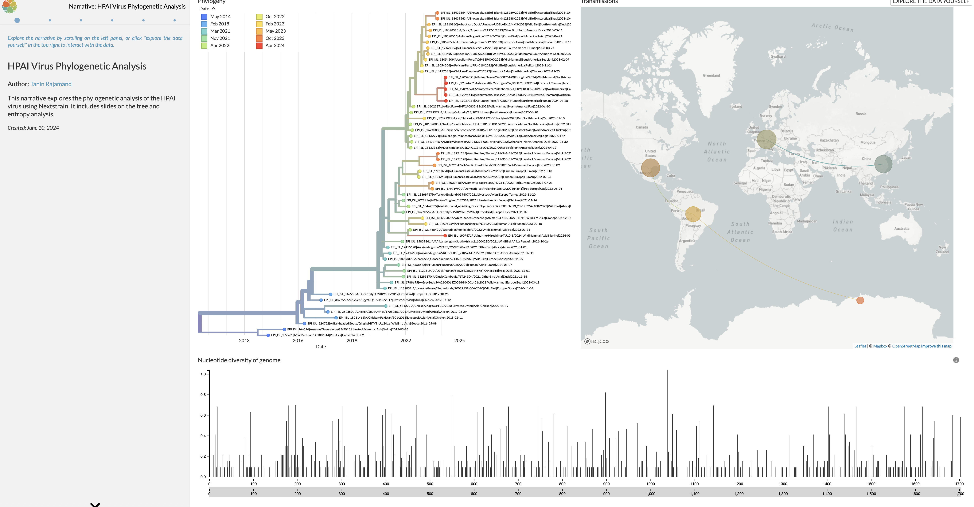
Your auspice visualization should look like this:

Slide 4
Research Aim:
Investigate Geographic Dispersal and Cross-spices Transmission Events of HPAI
Task:
Referring the the tutorial, use Nextstrain Narratives to annotate your Nextstrain Build to answer the research aim.

Slide 5
Share your build and narrative!

